Slide 1
ML-Powered Pneumonia Diagnosis from Chest X-Rays
Presented by: Arif

Slide 2
Agenda
01
02
03
04
05
06
Why Pneumonia Detection Matters
Understanding the Dataset
Data Preprocessing
Model Training & Performance
Model Explainability
Expert Radiologist Comparison

Slide 3
Agenda
07
08
Future Improvements
Summary & Key Takeaways

Slide 4
01
Why Pneumonia Detection Matters?

Slide 5
🎯 The Problem:
💡 The Objective:
Lung Infection is a leading cause of hospitalisations with Pneumonia being the most common.
Diagnosing Pneumonia through X-rays is time-consuming and requires expert radiologists.
AI has the potential to assist in faster and more accurate diagnosis.
Develop a ML model to classify Normal, Viral Pneumonia, and Bacterial Pneumonia from chest X-rays.
Use Grad-CAM to interpret model decisions.
Validate results with expert radiologists and showcase a live demo.
Notes:
Picture this—you’re feeling unwell, struggling to breathe, and decide to see a doctor. But the next GP appointment is weeks away. You go to A&E, only to wait for hours. When you finally get a chest X-ray, it takes even longer for a radiologist to review it.
This is the reality in the NHS—long wait times, overwhelmed hospitals, and delays in diagnosis. Pneumonia is a leading cause of hospitalizations, and early detection is critical.
AI can help. By analyzing chest X-rays in seconds, our model assists doctors in detecting pneumonia faster. Using Grad-CAM, we ensure transparency in AI decisions and validate them against expert radiologists.
The goal? Not to replace doctors, but to support them—helping patients get diagnosed and treated sooner.

Slide 6
02
Understanding the Data

Slide 7
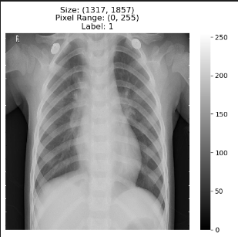
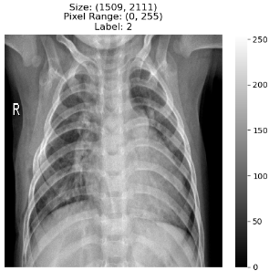
📊 Dataset Overview
Total Images: 5856 with a mixed number of normal, viral/bacterial pneumonia images.
Data Splitting: The dataset was immediately split into training and testing sets to avoid data leakage and ensure unbiased evaluation.
Notes:
Now that we understand the problem. The next step is to find high-quality data to train the ML model. The dataset used contains 5,856 chest X-rays, covering normal, viral, and bacterial pneumonia cases.
To prevent bias, we immediately split the data into training and testing sets, ensuring the model learns from one set and is fairly tested on another.
From the example X-ray images above; left (viral pneumonia) and right (bacterial pneumonia). You can see that each image has varying sizes and pixel intensity differences which aren’t useful as an input for the ML model.

Slide 8
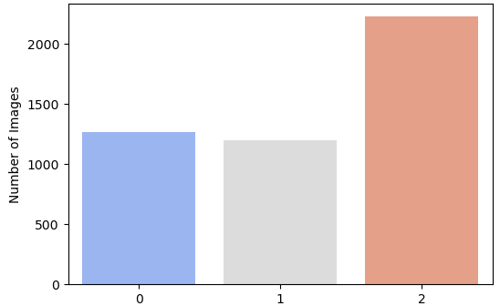
📊 Dataset Overview
Class Imbalance: Bacterial pneumonia cases dominate the dataset.
Distribution: 1,266 Normal, 1,194 Viral, 2,224 Bacterial cases.
Risk: Model may favour bacterial pneumonia due to imbalance.
Notes:
Now that we have our dataset, a major issue appears—class imbalance. Bacterial pneumonia cases significantly outnumber viral and normal cases, meaning the model could lean towards predicting bacterial cases more often.
This bias could lead to misdiagnoses in real-world scenarios, which is why we need data augmentation to balance the classes and ensure fair learning.
Next, let’s explore how we tackled this challenge during preprocessing.

Slide 9
03
Data Pre-processing

Slide 10
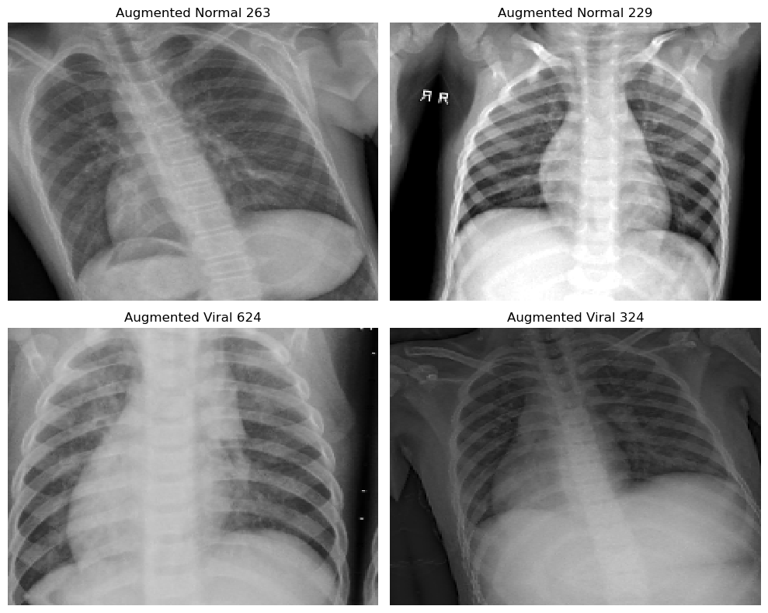
Steps Taken:
Resized images to a standard input size.
Normalized pixel values (0-1) to stabilize training.
Applied data augmentation (rotation, flipping, etc) to balance class distribution (2224 images each).
Expanded dimensions for compatibility with CNN.
Notes:
To make our model more robust, we needed to standardize and balance our dataset.
First, we resized all images for consistency and normalized pixel values for stable training. But the real challenge was the class imbalance. To fix this, we applied data augmentation—as seen here, the images were randomly rotated and flipped, increased/decreased brightness of underrepresented images to create more training samples.
Finally, we expanded image dimensions for compatibility with CNNs, setting up our model for optimal learning. Now, let’s talk about the model.

Slide 11
04
Model Training and Performance

Slide 12
🏗️Approach:
💡 The Objective:
Feature Extraction: Used the first two layers from the pre-trained VGG16 model to extract key features, particularly edges and textures in X-rays.
Custom CNN: Built and used for the deeper layers of the model, trained specifically on the dataset.
Batch size: 16 to improve generalisability.
Epochs: 90 for stable learning.
Loss function: Categorical cross-entropy (for multi-class classification).
Metrics: Accuracy, Precision, Recall, F1-score, and AUC.
Notes:
With our data ready, I designed a model that blends pre-trained knowledge with custom learning.
We used VGG16’s first two layers to extract key X-ray features like edges and textures, then built a custom CNN for deeper analysis. To improve generalization, we trained with a batch size of 16 over 90 epochs, using categorical cross-entropy for multi-class classification.
Performance was evaluated using accuracy, precision, recall, F1-score, and AUC, ensuring a well-rounded assessment. Now, let’s see how well it performed!

Slide 13
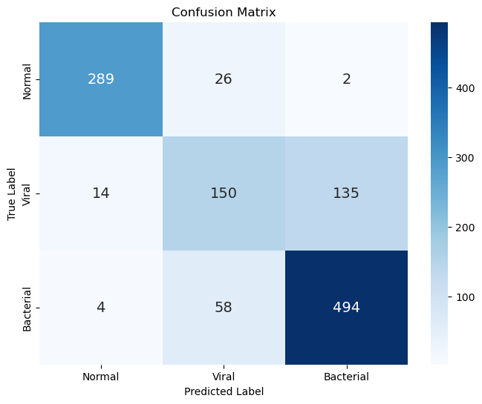
📊 Model Performance:
Model performs well on normal cases but struggles with bacterial vs. viral pneumonia.
Accuracy (test): 80% (underfits 2%)
Precision (test): 79% (overfits 1%)
Recall (test): 80% (underfits 5%)
F1-score(test): 79% (underfits 1%)
AUC (test): 91% (overfits 2%)
Notes:
Now that our model is trained, how well does it actually perform?
Overall, it does well on normal cases, but struggles to differentiate bacterial from viral pneumonia. With 80% accuracy, it slightly underfits, meaning there’s room for improvement. Precision and recall show a tradeoff, with an AUC of 91%, suggesting strong classification ability despite some misclassifications.
Looking at the confusion matrix, we see that the model sometimes mislabels viral pneumonia as bacterial, which could impact real-world diagnosis. This highlights the need for further refinement and expert validation.

Slide 14
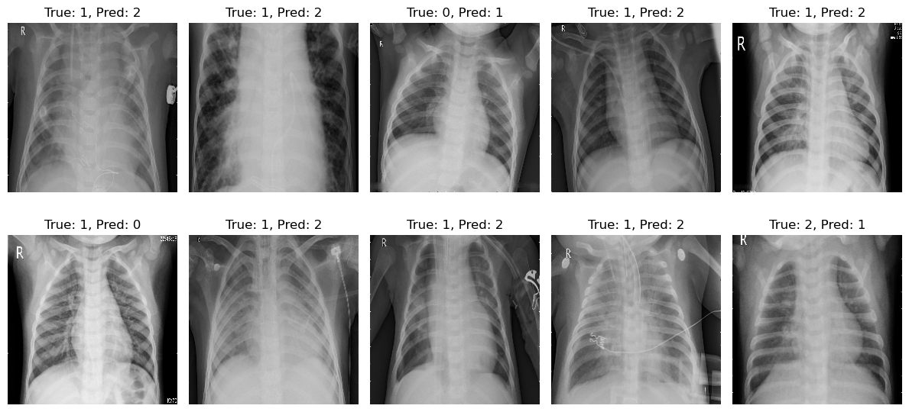
Notes:
We’ve seen that our model struggles with some cases—but why?
Here, we see some misclassifications, where viral pneumonia was mistaken for bacterial, or even normal cases were misclassified. Instead of guessing, we need explainability.
With Grad-CAM, we can visualize where the model is focusing, helping us understand if it’s looking at the lungs—or the wrong areas.

Slide 15
05
Model Explainability

Slide 16
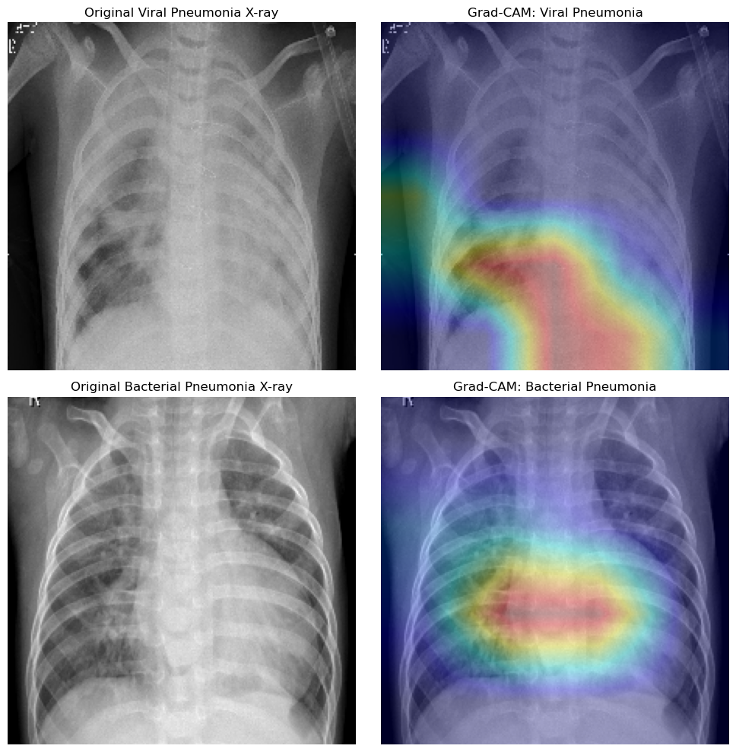
Notes:
Now we can see exactly where the model is looking when making its decisions.
These heatmaps highlight the most influential areas—red indicates strong focus. For bacterial pneumonia, the model focuses on the central lung, while for viral pneumonia, it looks lower in the lungs.
This shows the model is learning somewhat meaningful features, but there’s still room for refinement. Next, let’s compare these ML insights with expert radiologist opinions.

Slide 17
06
Expert Radiologist Comparison

Slide 18
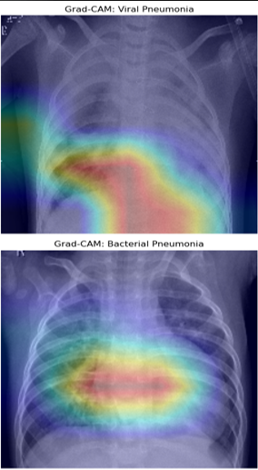
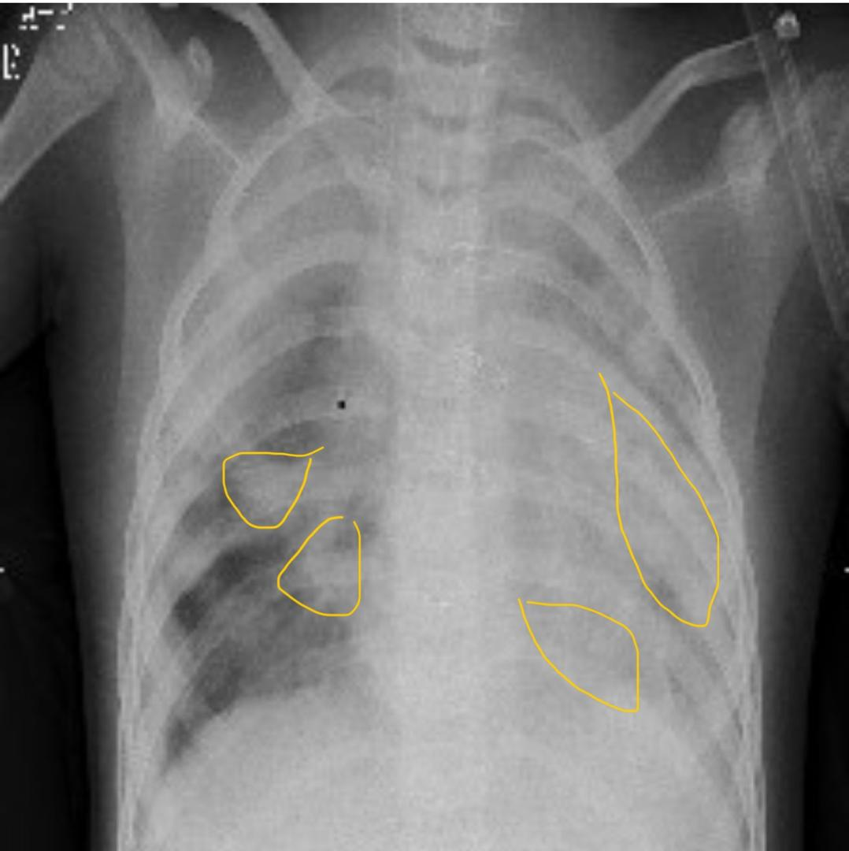
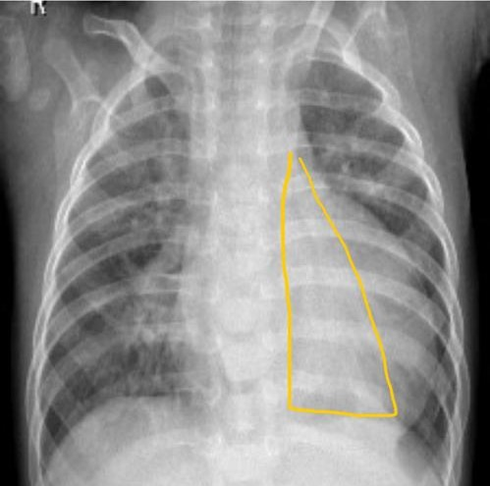
Notes:
So far, we’ve seen how our model makes predictions using Grad-CAM, but how does this compare to an expert radiologist’s assessment?
For viral pneumonia (top right), the radiologist highlighted thin, linear opacities in the airways, which is expected since viral infections often affect the bronchi and bronchioles. However, the Grad-CAM heatmap focuses lower in the lungs, potentially missing these airway patterns.
For bacterial pneumonia (bottom right), the doctor marked dense air space opacities, where the infection has filled the alveoli, a classic sign of bacterial pneumonia. The ML model correctly focuses on this area, but lacks the radiologist’s precision in distinguishing unilateral vs. bilateral patterns.
This comparison shows that while AI can detect general patterns, it doesn’t always focus on the most clinically relevant areas. This reinforces why AI should support, not replace, radiologists—bridging speed with expert decision-making.
Next, let’s explore how we can further refine the model.

Slide 19
07
Future Improvements

Slide 20
🔮 Limitations:
🚀 Next Steps & Enhancements:
Model struggles with viral vs bacterial pneumonia differentiation.
Potential dataset bias (not diverse enough).
Train on larger, more diverse datasets.
Fine tune the model more and train for longer epochs.
Explore hybrid ML + radiologist workflows for real-world deployment.
Create a live demo to show the functionality of the model.
Notes:
Our model performs well, but there’s room to grow.
To improve accuracy, we need more diverse data, better feature extraction, and longer training. Fine-tuning the architecture, ensemble learning, and self-supervised training can help.
We also aim to integrate uncertainty quantification, so the model knows when it’s unsure, and explore AI-radiologist collaboration for real-world use.
Additionally deploying a live demo on streamlit, enables medical professionals to test the model and provide feeback.
These steps will move us closer to a more reliable and clinically useful AI tool.

Slide 21
08
Summary & Key Takeways

Slide 22
🎯 Key Takeaways:
ML-powered diagnostics can assist radiologists, not replace them.
Grad-CAM helps interpret model decisions.
ML models can learn features but need guidance from expert radiologists to work better.
Future improvements can increase trust & real-world adoption.
Notes:
We’ve explored the potential of ML in pneumonia detection—from data challenges to model training, and finally, to explainability and expert validation.
One key takeaway is that ML has the potential to assist, but it needs expert guidance to be truly effective. While ML models detect patterns, radiologists ensure clinical accuracy.
Grad-CAM improves transparency, helping us trust AI decisions. With better data, refined models, and collaboration, we can move AI from research to real-world impact.
Ultimately, AI won’t replace radiologists—it will empower them, making diagnostics faster, more accurate, and more accessible.
Thank you for your time! Any questions?

